Slide 1
PowerShell: Paving the Path To Prosperity

Slide 3
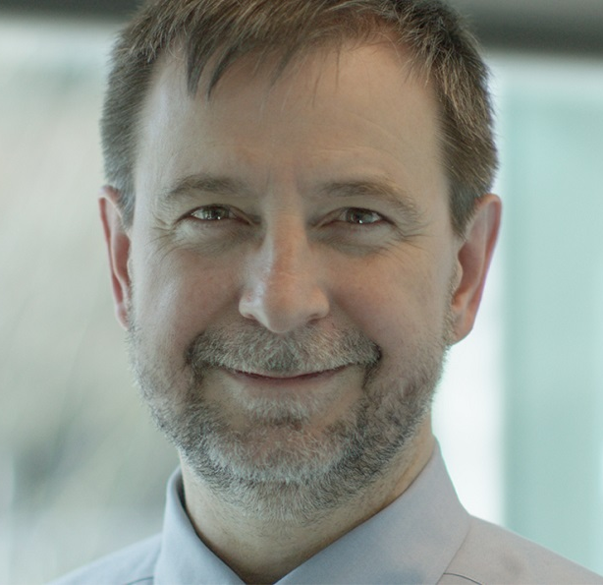
Inventor of PowerShell
Former Chief Architect for Windows Server
Chief Architect for Azure Infrastructure and Management
Twitter: @jsnover
Jeffrey Snover
Microsoft Technical Fellow

Slide 4
PS/Devops Summit AMA Questions
What would today’s Monad Manifesto say?
What’s the next “big thing” in PowerShell?
What does the PowerShell team re-org mean?
Are we at the end of the Monad Manifesto?

Slide 5
Is PowerShell Done?
YES!
and
NO!

Slide 6
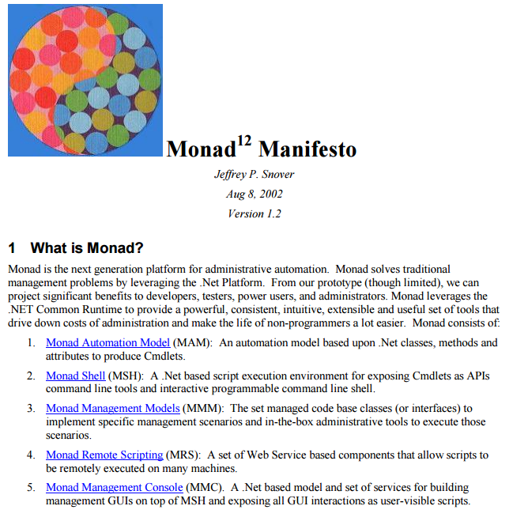
Monad Manifesto

Slide 7
Is PowerShell Done?
Automation Model
.NET, Script, Native (WMI), Workflows, Swagger
Shell
PowerShell.exe, PowerShell_ISE, PSReadline, VS, VS Code, Cloud Console
Ad hoc => Advanced scripting, Classes, Script Analyzer, PSGallery, Anti-Malware Integration, Security++
Remote Scripting
PSRP over WSMAN/NamedPipes/VMBus/OpenSSH, Remote Debugging
Management Models
Namespaces (SHIP), Jobs, JEA, PSGet, Pester/OVF, DSC
Management Console
Exchange Admin console, Server Manager, PowerGUI, ShowUI, Honolulu

Slide 8
Is PowerShell Done?
YES!
PowerShell has achieved critical mass as a general purpose Windows Scripting tool

Slide 9
But . . . The Cloud Changes Everything

Slide 10
PowerShell: Manager of the Hybrid Cloud
From ANY client
Manage ANY server
Running on ANY cloud
Or on-prem using:
ANY hypervisor
ANY storage
and ANY networking

Slide 11
Is PowerShell Done?
NO!

Slide 12
Hybrid Cloud Focus
FROM
TO
Windows
Cross Platform
Platform
Solutions
Servers
Services/Applications/Clouds

Slide 13
Architects View
Generalizable pattern behind the details
When faced with success:
Incremental change
Transformative change

Slide 14
Types of Change
Incremental | Transformative
We know the answer, we just need to implement it | We don’t know the answer (or question)
Sharpen our thinking | New way of thinking
High probability of success | Failures WILL happen
Same identity & customers | New identity & customers
Team stays intact | Not everyone makes it

Slide 15
Transformational Changes Are Hard

Slide 16
Easy To Fail at Transformative Change
Just treat it like an incremental change

Slide 17
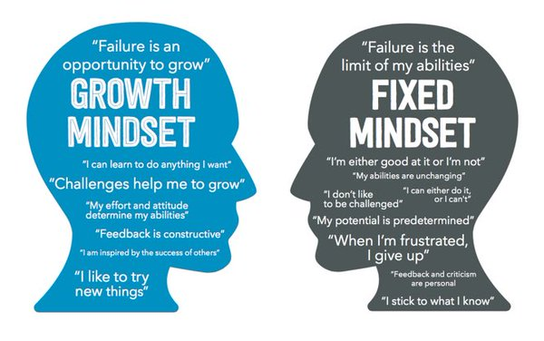
Transformation Requires A Growth Mindset

Slide 18
Examples of Transformative Change
Windows GUI => Automation
Mgmt of Silos => Mgmt of the full portfolio
Traditional IT => DevOps
On Premises => Cloud
Windows PowerShell => Core PowerShell

Slide 19
Core PowerShell is a Transformative Change

Slide 20
PowerShell: Manager of the Hybrid Cloud
From ANY client
Manage ANY server
Running on ANY cloud
Or on-prem using:
ANY hypervisor
ANY storage
and ANY networking

Slide 21
Core PowerShell is Open Sourced
Source => GitHub
Build
Test
Community Governance & Process
Launch partners: AWS, VMware, and Google

Slide 22
Core PowerShell Runs On Linux and Windows
Core .NET
Cultural Compatibility
& backgrounding
Case-sensitivity
Globbing for native cmds
File encodings
Aliases
Support for SSH
Equal standing with Windows => VS Code
Improve native pipelining

Slide 23
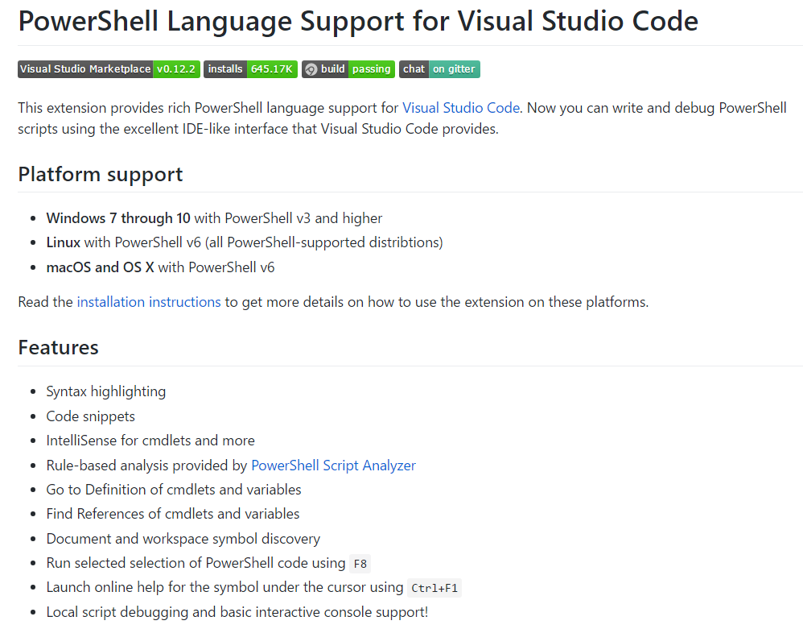
OSS: Editor Services & VSCode
David Wilson and Keith Hill are maintainers

Slide 24
Core PowerShell & DevOps
Developer enhancements
VS Code
Classes++
PS Script Analyzer
Remote script debugging
DSC resource debugging

Slide 25
Core PowerShell In Azure
Cloud Command Console
DSC as Native Azure Configuration
Common Windows & Linux LCM
Multiple LCM instances
Native code LCM for lightweight environments
LCM as a Library

Slide 26
Is PowerShell Done?
NO!

Slide 27
Hybrid Cloud Focus
FROM
TO
Windows
Cross Platform
Platform
Solutions
Servers
Services/Applications/Clouds

Slide 28
PowerShell: Manager of the Hybrid Cloud
From ANY client
Manage ANY server
Running on ANY cloud
Or on-prem using:
ANY hypervisor
ANY storage
and ANY networking

Slide 29
WHY?

Slide 30
PS Supports YOUR Transformative Changes
Windows GUI => Automation
Mgmt of Silos => Mgmt of the full portfolio
Traditional IT => DevOps
On Premises => Cloud

Slide 31
Succeeding with Your Transformative Change
No playbook | Uncomfortable is the new norm
New way of thinking | Go back to first principles
Failures WILL happen | Adopt a growth mindset
New identity and customers | Have courage and confidence in the path
Not everyone makes it | Don’t let adverse facts stand in the way of a good decision

Slide 32
Summary
PowerShell is:
All about making YOU successful
Widely used throughout the industry
Transforming to enable you to solve bigger and harder problems
So that you can be a hero and get rewarded

Slide 33
ANY Questions?

Slide 34
Thank You!

